Slide 1
Ultimate Storage Rings
PEP-X and SPring-8 II
R. Hettel for the PEP-X design team
and T. Watanabe et al., SPring-8
FLS 2012
JNAL
March 7, 2012

Slide 2

What is the Future of X-ray Sources at SLAC?
2 km warm linac (33 GeV) + damping rings:
  PEP injection
  FACET
  LCLS 2
1 km warm linac (16 GeV):
  LCLS 1
LCLS injector
PEP-II
SPEAR3
LCLS
LCLS 2

Slide 3
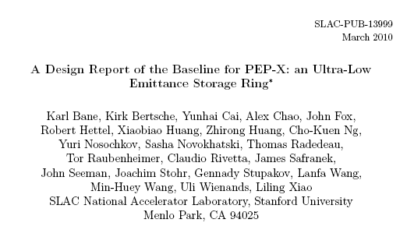
PEP-X Design Study

Slide 4
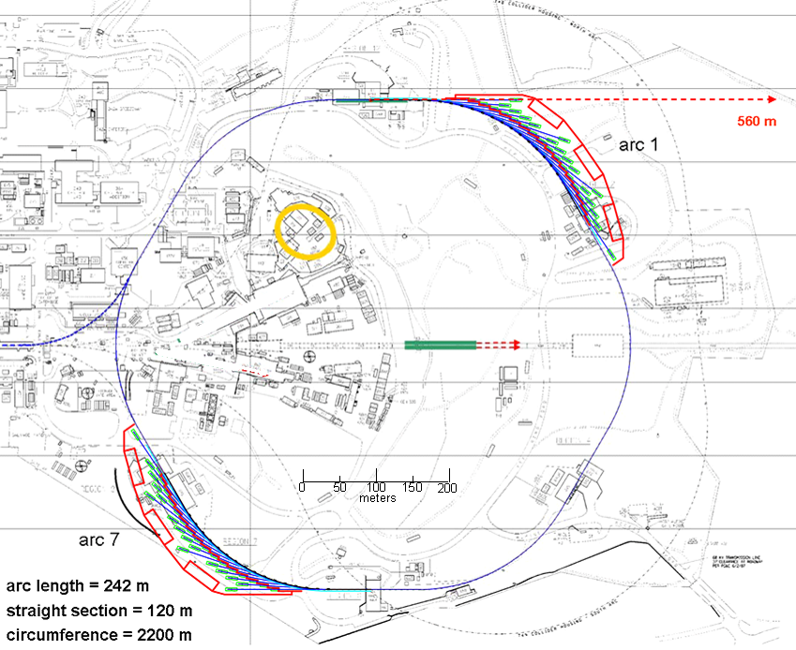
PEP-X Baseline Concept (consolidated experimental halls)
E = 4.5 GeV
I = 1.5 A
ε_{x} = 150 pm-rad
(~0.06 nm-rad w/o IBS)
ε_{y} = 8 pm-rad
σ_{s} = 3/6 mm
(without/with 3rd harm rf)
= ~1 h
top-up injection every few seconds (~7 nC, multiple bunches)
2 arcs of DBA cells with 32 ID beam lines (4.3-m straights)
4 arcs of TME cells
~90 m damping wigglers
6 ea 120-m straights for injection, RF, damping wigglers long IDs, etc.
Same coherent flux as 11-pm USR: higher emittance and current

Slide 5
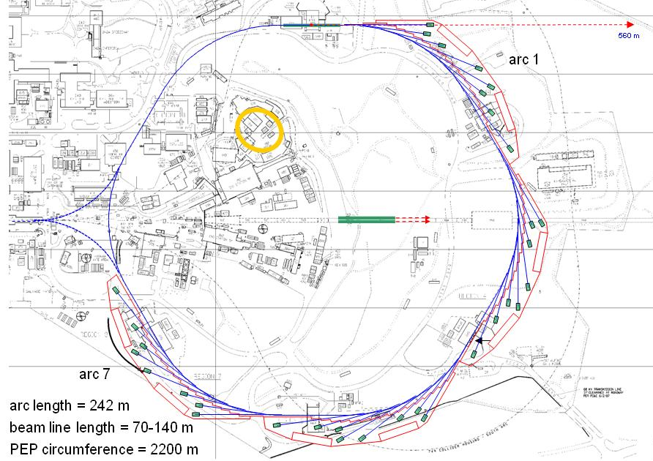
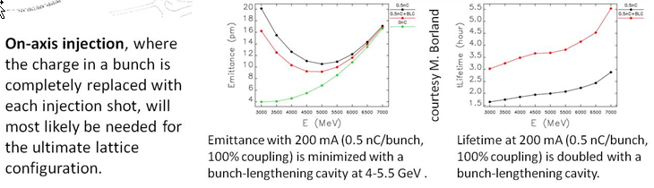
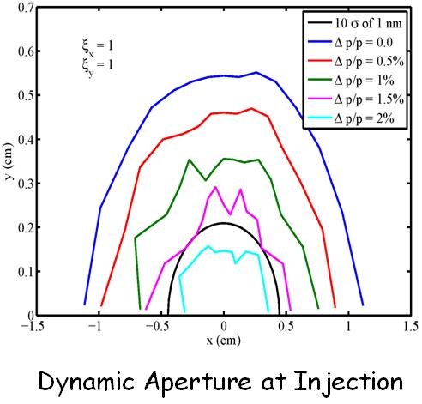
PEP-X: Diffraction-Limited Storage Ring at SLAC
Energy 4.5-5 GeV
Current 200 mA
Emittance (x/y) 11/11 pm
Bunch size (x/y, ID) 7.4/7.4 μm rms†
Bunch length 4 mm rms*
Lifetime >2 h*
Damping wigglers ~90 m
ID length (arc) ~4 m
ID length (straight) <100 m
Beta at ID center, (x/y) 4.92/0.8-5 m
Circumference 2199.32 m
Harmonic number 3492
† Vertical beam size can be reduced towards 1 μm
* Harmonic cavity system would increase bunch length to ~8 mm and double the lifetime
sufficient dynap for off-axis injection
7BA cell

Slide 6
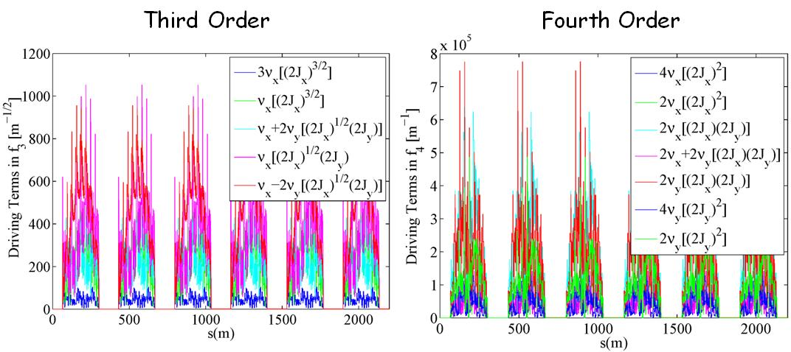
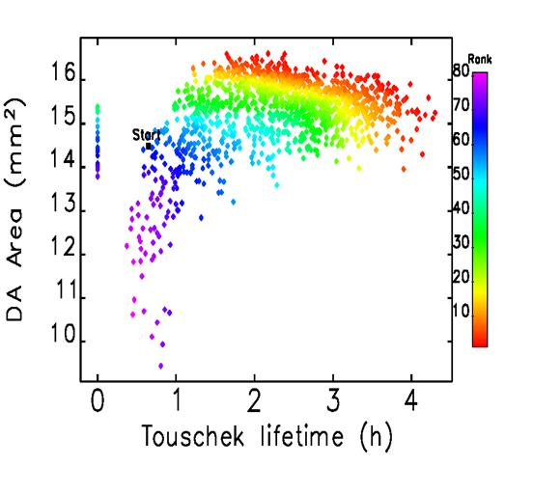
Multibend Achromat Cells
7BA cell
modified from MAX-4
cancelling all 3rd and 4th order resonances except
2ν_{x}-2ν_{y}
Y.Cai et al., SLAC-PUB-14785, 2011
optimizing dynap and lifetime
with ELEGANT
M. Borland

Slide 7
USRs - Spectral Brightness

Slide 8
USRs – Coherent Fraction

Slide 9
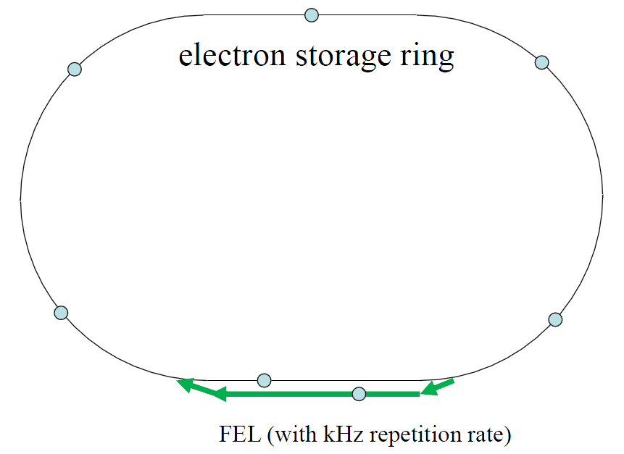
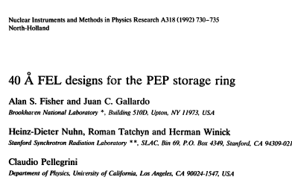
PEP-X Soft X-ray FEL in switched bypass
    E_{e-} = 4.5 GeV ε_{x,y} = ~11 pm-rad
    λ_{FEL} = 1 nm λ/4π = 80 pm-rad
    I_{pk} = 300 Apk L_{ID} = 50-100 m
    P_{pk} = few hundred kW rep rate: kHz
Can inject special short, high peak current bunch to lase for a few turns

Slide 10
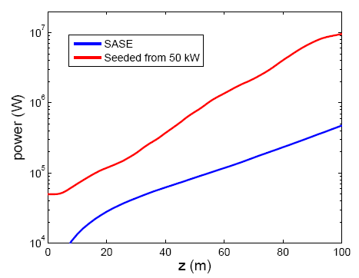
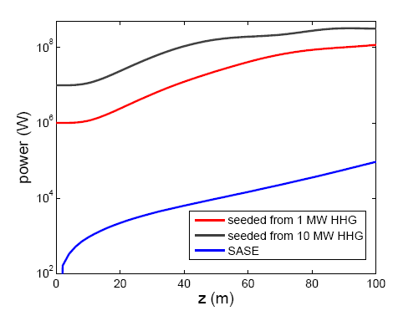
Soft X-ray Partial Lasing with Stored Beam in PEP-X
Z. Huang, C. Pellegrini et al.
3.3 nm
379 eV
30 nm
42 eV
Preliminary studies show that radiation from 50-100 m undulator whose first harmonic is tuned to < ~380 eV (> 3.3 nm) would be enhanced by one to two orders of magnitude by the SASE FEL process acting with the stored beam.

Slide 11
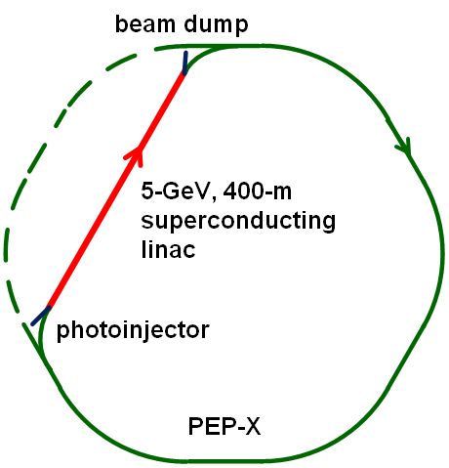
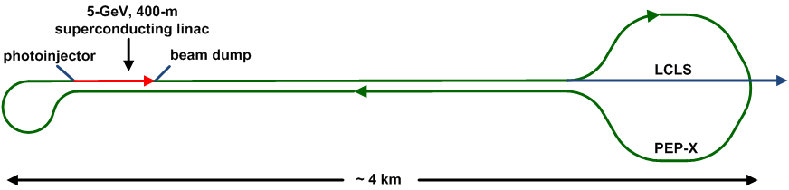
PEP-X ERL – some options
Option: 2-pass with 2.5-GeV linac
SCRF = 1.3 GHz
“bunch stealing” @ ~ 1 MHz could drive FELs

Slide 12
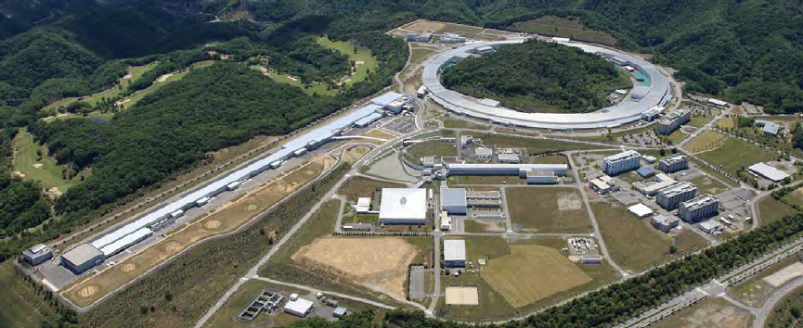
SPring-8 II
http://www.spring8.or.jp/en/about_us/whats_sp8/spring-8_II

Slide 13
SPring-8 upgrade plans (from T. Watanabe)
Goal:
  - Significant improvement in light source performance, especially brilliance
  - In 2019 with 1 year shutdown
  - Cost range: approx. 40 billion Japanese yen
“Boundary conditions”:
  - To take full advantage of existing resources
    >> Reuse the existing tunnel
  - ID beamline hutches should not be moved.
  - Same X-ray spectral range : a few to 100 keV
  - Good stability

Slide 14
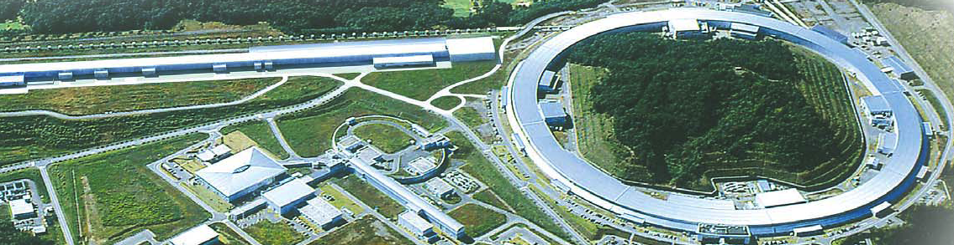
SPring-8 II – at-energy linac injector
A high-quality injection beam is needed.
At SPring-8 we have XFEL Linac, which will be used as a full-energy injector to the storage ring.
XFEL(SACLA)
Booster
SR
Linac Parameters:
(typical)
Energy: 8 GeV (max.)
Emittance: 40 pm.rad
Energy Spread: 0.01 %
Bunch Length: 30 fs (rms)
Electron Charge: 300 pC – 1 nC

Slide 15
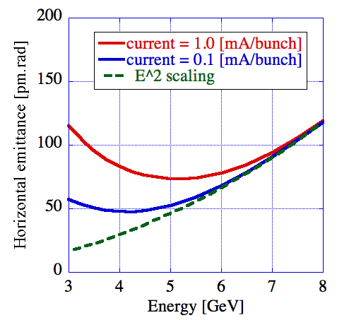
SPring-8 II – electron energy
Intra-beam scattering (IBS)
6 GeV is better than
8 GeV up to 100+ keV
4 – 6 GeV is the best
6 GeV is presently assumed, but 4.5-5 GeV under consideration

Slide 16
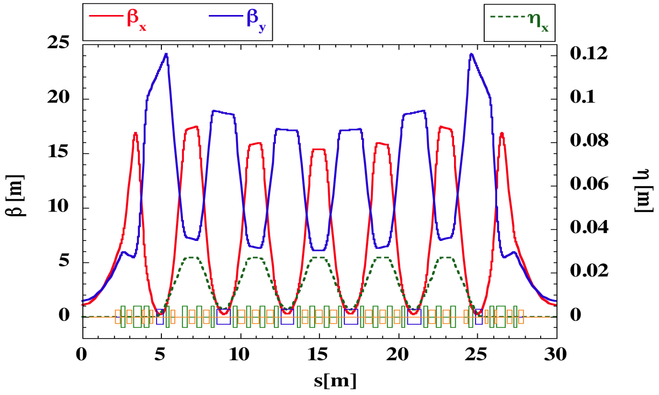
SPring-8 II – 6-bend achromat lattice
(Electron energy)²
Emittance = K
X
D
(# bends)³
Natural emittance
= 67 pm.rad
＋
Damping by ID's
Damping wiggler
Damping partition control
Coupling control
etc...

Slide 17
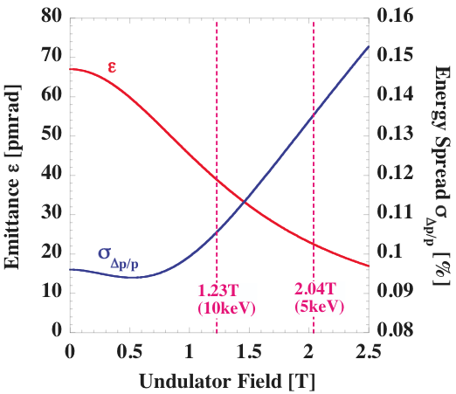
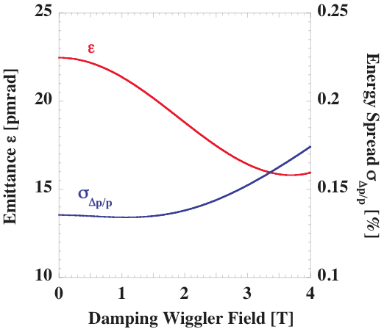
SPring-8 II – damping by IDs and wigglers

Slide 18
 | SPring-8 | SP-8 II (planned)
Electron energy | 8 GeV | 6 GeV
Current | 100 mA | ~300 mA
Emitance | 3.4 nm.rad | 67→10 pm.rad
Energy spread | 0.0011 | ~0.001
Coupling | 0.2 % | ~2 %
Bunch length (rms) | 13 ps | >20 ps
Circumference | 1436 m | 1436 m
# beamlines | 62 max. | 62+ max.
* Parameters for SP8-II may be changed.

Slide 19
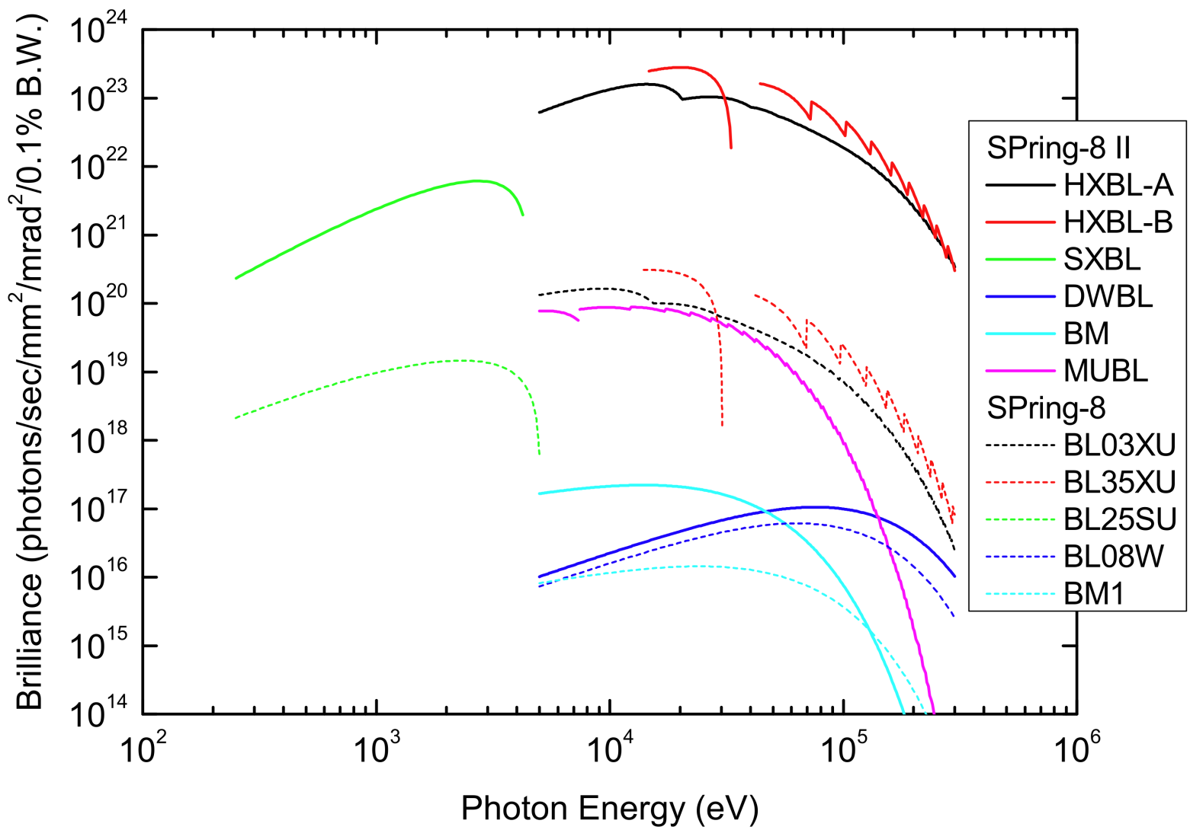
Brilliance: SPring- 8 vs. SPring-8 II
X 1000
Energy : 6 GeV
Emittance: 35 pm.rad
Coupling: 2 %
Energy spread: 0.1%
Current: 300 mA

Slide 20
SPring-8 II – possibility of short bunch operation
1) ~ 1 ps, using x3.5 harmonic cavity
2) Should not affect extremely small emittance bunch
Rough image:
SP-8 II
40ps
40ps
1ps
40ps
XFEL
~10 fs
Now under discussion with users

Slide 21
SPring-8 II – new injection scheme
※DA ~ ±3 mm
A single device that enables both
on- and off-axis injections

Slide 22
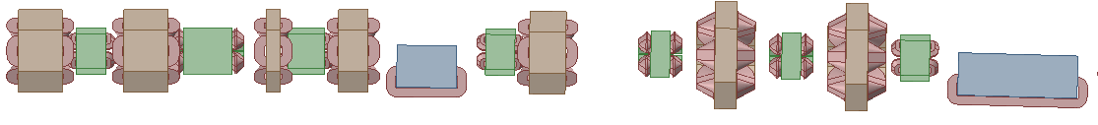
SPring-8 II – strong multipole magnets
A quarter of the unit cell
Beam
Critical magnets
Need R&D
New vacuum design necessary

Slide 23
SPring-8 II – new RF system

Slide 24
SPring-8 II – harmonic RF system
e-bunch needs to be lengthened
for lifetime and less IBS effect
New higher harmonic RF system
enables it.

Slide 25
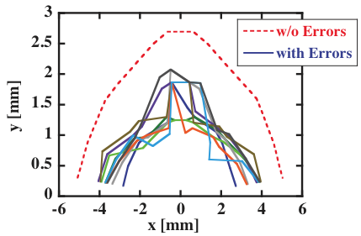
SPring-8 II – dynamic aperture
Dynamic aperture
with 20um SX errors
Sextupole alignment error: σ = 10 μm, cutoff = +/-20 μm

Slide 26
SPring-8 II – Summary
- Goal: ~10pm.rad = ultimate storage ring
- Planned for 2019 with one-year shutdown
- Take full advantage of existing resources
- Now under extensive studies for lattice design and technology developments
- Challenging issues clarified
- New components proposed and studied, but need more
- A couple of design alternatives. Open to any change.
- R&D will start in FY2012

